Slide 1
Smithgall Woods Park Website
Project Updates
MIST7590 – MIT Project I
Andrea Castresana
Jennifer Lazo
Alexander Couch
Clark Williams
Eliseo Santos
November 15, 2017

Slide 2
Overview
SGW Background
Team Member Roles
Project Schedule
Project Task Accomplishments
Site Security & Maintenance
System Requirements
User Stories
Use Case Diagrams
Site Map
Workflow Diagrams
Data Models
Way Ahead

Slide 3
Background
Friends of Smithgall Woods Park is a state park in Helen, GA
Recreational activities include fishing, hiking, camping, and volunteering
Part of the site is used to track Friends Chapter members’ volunteer hours which are reported to the state, and SGW earns revenue
Other parts of the site provide links to external websites such as
Lodging Reservations
Newsletter Subscription
Becoming a SGW Friend and Volunteer
Signing up for Volunteer Opportunities

Slide 4
Team Member Roles
Team Leader/Project Manager – Eliseo
Client-side Developer – Jennifer, Andrea
Server-side Developer – Jennifer, Alex, Eliseo
Database Manager – Eliseo, Clark
UI/UX Design Manager – Alex, Jennifer
Test Manager – Eliseo, Clark
Business Requirements Manager – Andrea, Clark

Slide 5
Project Schedule
 |  | CY2017 |  |  |  | CY2018
Task Phase | Task Description | S | O | N | D | J | F | M | A
Initiation & Planning | Conduct System Analysis of Current Website
 | Propose Security Remediation Plan
 | Establish Proposed System Requirements
 | Meet with Project Stakeholders
 | Develop Logical Models
 | Conduct Testing of WordPress & Prototype
 | Research Web Content Management Tool
 | Finalize Requirements & Project Charter
Project Execution | Start Rebuilding the Website
 | Test First Increment Version of Website
 | Finish Rebuilding the Entire Website
 | Test Final Rebuild of Website
Project Closure | Establish Documentation
 | Deploy Production Version of Website
 | Conduct Training on Website Maintenance
 | Hold Project Closure Meeting with Client

Slide 6
Project Task Accomplishments
Investigation of SGW website
Discovered unnecessary admin accounts
Found outdated plugins
Identified malicious injected code & disabled it temporarily
Proposed temporary solution to security vulnerability
Gathered & prioritized user requirements
Developed prioritized rqmts into proposed system rqmts
Created home page mockups for Mobile & PC views
Conducted/Recorded testing of WordPress & prototype
Updated WP & PHP software; removed suspicious files

Slide 7
Site Security & Maintenance
~June 6, 2016 – site was successfully hacked
Malicious code was injected & messages displayed in multiple site pages
Identified and disabled the injected base64 code
October 29, 2017 – unsuccessful hacking attempt
Hacker attempted to change several code files
Hacking originated from Ukraine & Netherlands
Site host automatically locked 3 affected files
Updated all account passwords
Updated WP, plugins, and PHP software

Slide 8
Website Features | System Requirements | Priority
1.0 Website Pages (Site navigation & content presentation) | 1.1 Each site page shall display a menu bar with the following categories that contain relevant subcategories to allow users to find information quickly and provide better user experience: Home, About Smithgall, Activities, Events, Volunteer Opportunities, Contact Us, and Friends Corner. Currently, several subcategories are grouped under unrelated headings such as About Smithgall, Friends Chapter, etc. | High
 | 1.2 The website shall include “About Us Friends” page with links to http://www.gastateparks.org/smithgallwoods. This page will include information about the Friends Chapter and schedule of events. Its design will be consistent with the rest of the site. | High
 | 1.3 The website shall display an additional web page that provides information about “All Access” trail, and its design will be consistent with the rest of the site. | High
 | 1.4 Each page shall use darker font with higher contrast background and consistent line spacing, font type/size, and bold-type font that provides better user experience: double-line spacing between paragraphs, after page titles, and after subheadings; at least 26pt bold font for page titles and at least 20pt bold font for subheadings. | High

Slide 9
Website Features | System Requirements (Continued) | Priority
2.0 Website Construct | 2.1 The website shall be rebuilt using a user-friendly web content management tool that allows SGW representative to easily maintain and update the site. The tool shall also provide intuitive user interface that allows administrators to easily change text, photos, and site features. | High
 | 2.2 Instructions and training sessions will be provided in “real world English” to representatives so that they understand how to address any issues and how to maintain the site. | High
4.0 Cottage Accommodations Page | 4.1 Page shall link directly to the relevant state park lodging reservations page. All hyperlinks shall be active and current. | High
 | 4.2 Details shall be provided for each lodging location such as different attractions, landmarks, trails, etc. to help users refine their search based on what they want to see. | High
5.0 Volunteer Hours Log Page with Mobile Capability | 5.1 The Volunteer app shall allow Friends Chapter Member volunteers to create user account with their name, date of birth, home address, email, and phone numbers. It shall also allow a park representative to create Volunteer user accounts. For volunteers that are NOT Friends Chapter members, their hours are tracked through the Georgia State Park website. | High
 | 5.2 Volunteers with user accounts shall be able to log their volunteer date, time, locations, and tasks performed. | High

Slide 10
Website Features | System Requirements (Continued) | Priority
5.0 Volunteer Hours Log Page with Mobile Capability (Continued) | 5.3 The Volunteer page shall be formatted for mobile browsers using Bootstrap for ease of viewing and item selection. Site forms shall be formatted for mobile browsers using Bootstrap to make data entry easier and reduce the amount of typing required. | High
 | 5.4 Total volunteer hours for Hardman Farm shall be tracked also through SGW website. Volunteer Hours table in the database will include the Hardman hours with distinct label. The Hardman Farm manager will be given access to the site to log in all Hardman volunteer hours or the volunteers will log in their Hardman Farm hours at the same site using a selector to distinguish them from their other volunteer hours. | High
6.0 Volunteer Report Generator with Separate Login Page | 6.1 SGW app shall generate quarterly volunteer reports showing all hours for each volunteer name, the total hours of each volunteer, and the total of all hours for specified date range. The app shall be able to search the database by Activity, Location, and Project with volunteer hours totaled by Name, search area, and date range. | High
 | 6.2 SGW app shall be capable of setting up admin access to Report Generator for designated individuals only. | High

Slide 11
User Stories
As a/an | I need to….. | so that
Friends Chapter Member | Create a member/user profile | I can log in my volunteer hours data as a Friends Chapter member.
 | Edit my member/user profile | I can keep my information updated.
 | Update my list of interests | SGW can notify me of park activities that I’m interested in.
 | Add volunteer hours | SGW can keep track of my volunteer hours and earn revenue from the state.
 | View my volunteer hours | I can easily inquire of my total volunteer hours to date.
 | Review volunteer opportunities | I can volunteer my time to SGW.
 | Read newsletter | I can stay informed of the park events.
Administrator | Create & edit admin profile | I can give SGW staff personnel access to the Volunteer Hours Log Page.
 | Delete admin profile | I can remove a departing SGW staff member from the system.
 | Create & edit volunteer profile | I can help other Friends Chapter members who are not able to create their own volunteer profile.
 | Delete volunteer profile | I can remove the individuals who are no longer Friends Chapter members.
 | Input volunteer hours | I can help other Friends Chapter members who are not able to input their own volunteer hours to the system.
 | Update text, photos, & site pages/features | I can keep the SGW website current and provide site visitors better user experience.
Visitor | Navigate easily through the website | I can easily find interesting activities for me, my friends and family.
 | Find information about renting a cabin | I can look at several options before making my cabin reservation.

Slide 12
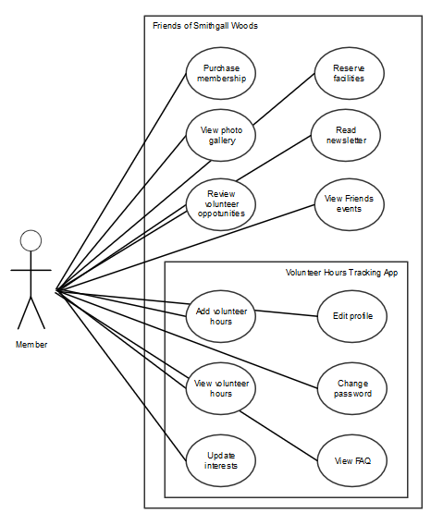
Friends Volunteer Use Cases
Notes:
The person who performs volunteer work for Smithgall Woods (SGW) is a Friends Chapter member. All other volunteers that are NOT Friends Chapter members are tracked through the Georgia State Park website.

Slide 13
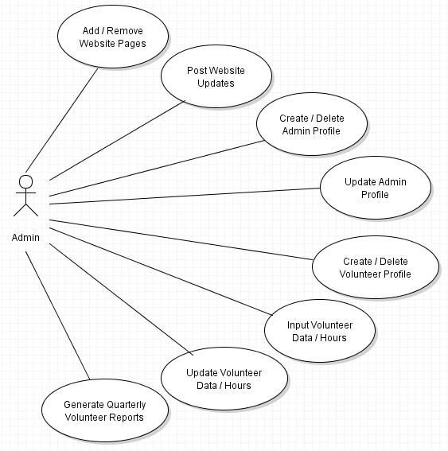
Admin Use Cases
Notes:
The last bubble “Placeholder for Volunteer Use Cases” is only used in this diagram to indicate some use cases from the Volunteer actor.

Slide 14
Site Map
Notes:
This Admin Workflow is based on the proposed user/system requirements. A separate login page for Admin will be developed, and an Admin/Password pair will be set up initially in the MySQL “admin_login” table. Then, the Admin must log in first to create user accounts with admin privileges.

Slide 15
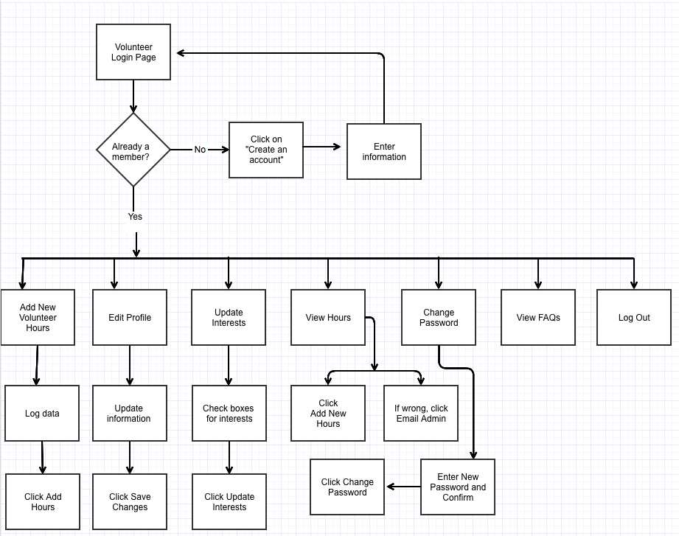
Friends Volunteer Workflow
Notes:
This Friends Volunteer workflow describes the existing Friends Volunteer Log process. The next iteration of the website will use similar workflow for the Friends Chapter member volunteer. The volunteer page starts with a login, and a member volunteer will still be able to Add New Volunteer Hours, Edit Profile, Update Interests, View Hours

Slide 16
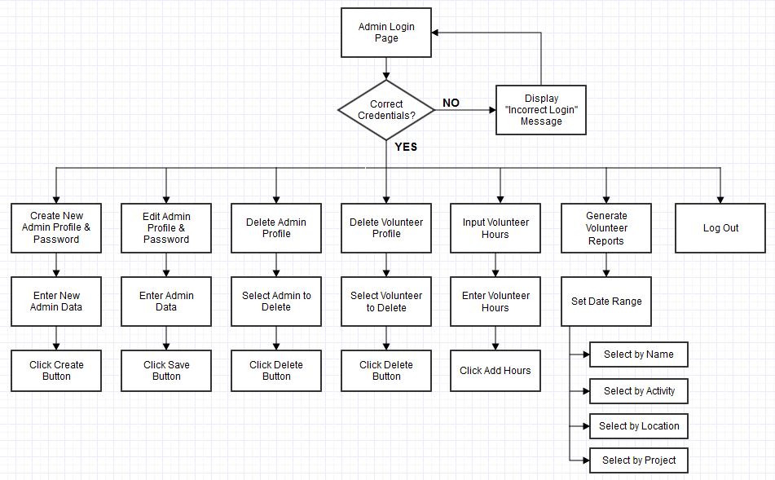
Admin Workflow
Notes:
This Admin Workflow is based on the proposed user/system requirements. A separate login page for Admin will be developed, and an Admin/Password pair will be set up initially in the MySQL “admin_login” table. Then, the Admin must log in first to create user accounts with admin privileges.

Slide 17
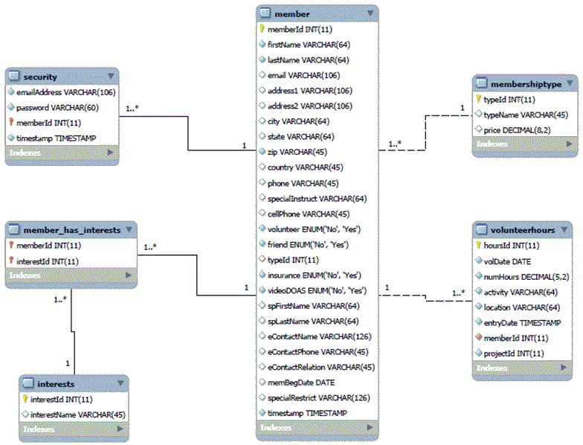
Existing Data Model
Notes:
Based on the team’s initial assessment of the SGW’s existing databases, only six tables were originally defined as shown here with one-to-many relationship. The rest of the tables in the databases were defined without references or relationships and are used as storage of web contents.

Slide 18
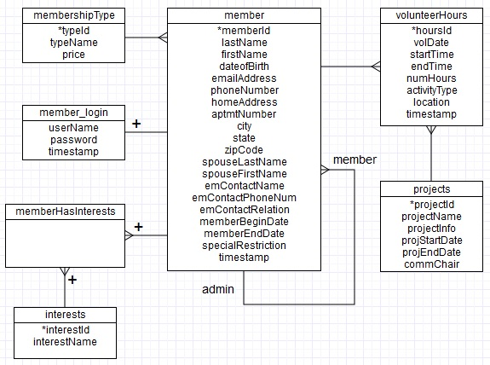
Suggested Data Model
Notes:
This data model is based on the proposed user/system requirements. The “admin” and “projects” tables are added and related to the “volunteer_hours” table with one-to-many relationship as shown here. In the “volunteer_hours” table, two attributes (approvalStatus and approvedBy) are also added for Admin validation of volunteer data.

Slide 19
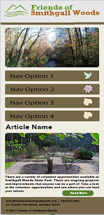
Home Page Mockup (Mobile Version)
Notes:
This is just one of the suggested mobile views…….

Slide 20
Way Ahead
Train all team members on WordPress & PHP
Assign site rebuilding tasks to each member
Begin rebuilding website next month
Notes:
The initial list of user and system requirements were provided to Mr. Pease for his review. Based on his feedback, we’ve updated these requirements. However, we have three open action items that we’re coordinating with Mr. Pease before we finalize these requirements: 5.2, 5.4, & CMS tool for maintainability and ease of use. After we clear these action items, we’ll provide Mr. Pease and Dr. Huber the updated Project Charter in the next couple of weeks for their review and blessing.

Slide 21
Questions

Slide 22
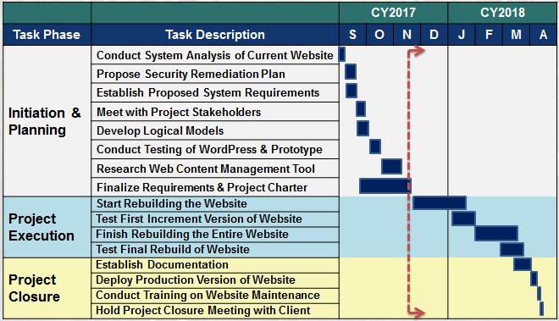
Project Schedule

